Slide 1
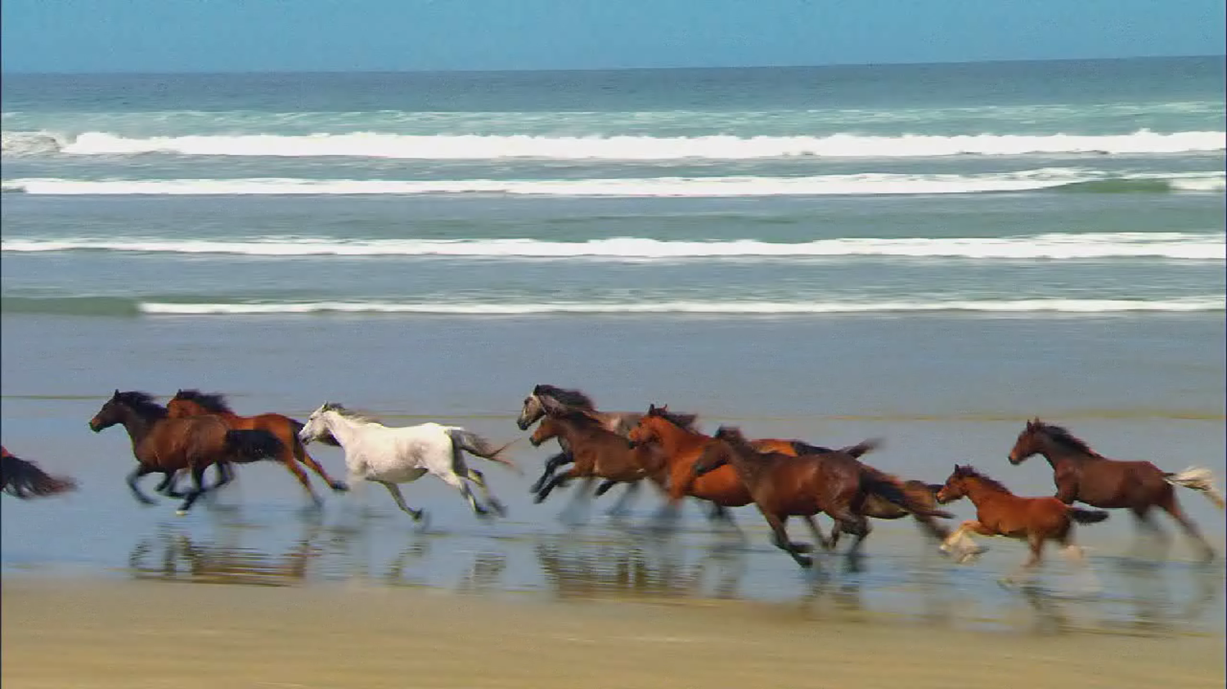
The video on this page has been cut and pasted as a PICTURE. Transition set to ON CLICK. There is a transparent full slide shape with an ACTION SETTING of ‘Next Slide’

Slide 2

This is the real video and is set to PLAY After Previous. The slide transition is set to auto after zero seconds and will change as soon as the video ends.

Slide 3
The Next Slide

